Slide 1
Parallel Programming Chapter 2 Introduction to Parallel Architectures Johnnie Baker January 23, 2011

Slide 2
Overview
Some types of parallel architectures
SIMD vs. MIMD
multi-cores from Intel and AMD
Sunfire SMP
BG/L supercomputer
Clusters
Later in the semester we’ll look at NVIDIA GPUs
An abstract architecture for parallel algorithms
Discussion
Sources for this lecture:
Primary Source: Mary Hall, CS4961, University of Utah
Larry Snyder, http://www.cs.washington.edu/education/courses/524/08wi/
Textbook, Chapter 2

Slide 3

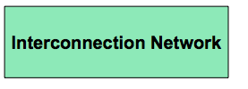

An Abstract Parallel Architecture
How is parallelism managed?
Where is the memory physically located?
Is it connected directly to processors?
What is the connectivity of the network?

Slide 4
Why Look at Architectures
There is no canonical parallel computer – a diversity of parallel architectures
Hence, there is no canonical parallel programming language
Architecture has an enormous impact on performance
And we wouldn’t write parallel code if we didn’t care about performance
Many parallel architectures fail to succeed commercially
Can’t always tell what is going to be around in future years
Challenge is to write parallel code that abstracts away architectural features, focuses on their commonality, and is therefore easily ported from one platform to another.

Slide 5
Viewpoint (Jim Demmel*)
Historically, each parallel machine was unique, along with its programming model and programming language.
It was necessary to throw away software and start over with each new kind of machine.
Now we distinguish the programming model from the underlying machine, so we can write portably correct codes that run on many machines.
MPI now the most portable option, but can be tedious.
Writing portable fast code requires tuning for the architecture.
Parallel algorithm design challenge is to make this process easy.
Example: picking a blocksize, not rewriting whole algorithm.
* James Demmel is a distinguished prof of Math & CS at UCB

Slide 6
Six Parallel Architectures (from text)
Multi-cores
Intel Core2Duo
AMD Opteron
Symmetric Multiprocessor (SMP)
SunFire E25K
Heterogeneous Architecture (ignore for now)
IBM Cell B/E
Clusters (ignore for now)
Commodity desktops (typically PCs) with high-speed interconnect
Supercomputers
IBM BG/L
Shared Memory
Distributed Memory

Slide 7
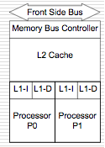
Multi-core 1: Intel Core2Duo
Two 32-bit Pentiums on chip
Private 32K L1 caches for instructions (L1-I) and data
Shared 2M-4M L2 cache
MESI cc-protocol provides cache coherency
Shared bus control and memory
Fast on-chip communication using shared memory

Slide 8
MESI Cache Coherence
States: M=modified; E=exclusive; S=shared; I=invalid;
Think of it as a finite state machine
Upon loading, a line is marked E, subsequent reads are OK; write marks M
Seeing another load, mark as S
A write to an S, sends I to all, marks as M
Another’s read to an M line, writes it back, marks it S
Read/write to an I misses
Related scheme: MOESI (O = owned; used by AMD)

Slide 9
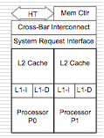
AMD Dual-Core Opteron (in CHPC systems)
Two 64-bit processors on a chip
64K private L1 data & instruction caches
1 MB private L2 cache
MOESI cc-protocol
Direct connect shared memory
Fast on-chip communication between processors

Slide 10
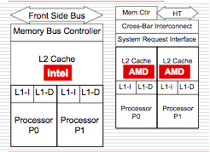
Comparison
Fundamental difference in memory hierarchy structure and cache coherency protocol
More details about these protocols in textbook

Slide 11
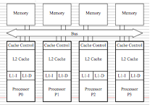
Classical Shared-Memory, Symmetric Multiprocessor (SMP)
All processors connected by a bus
Cache coherence maintained by “snooping” on the bus
Serializes communication – usually limiting nr of processors to ~20
AMD Dual Core has architecture well suited to construct an SMP.

Slide 12
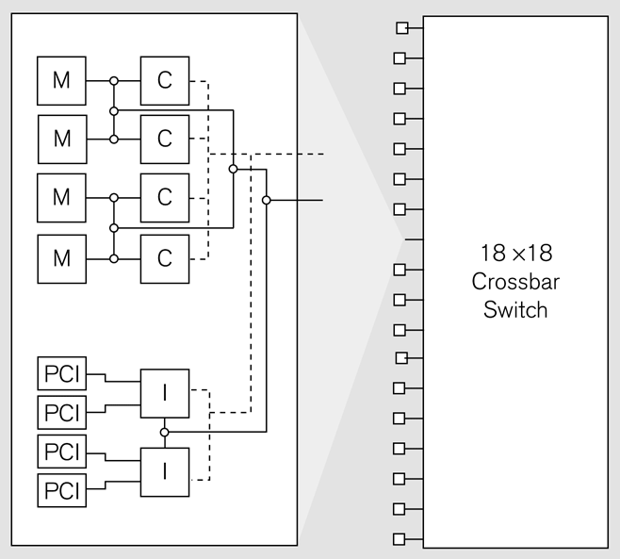
SunFire E25K
An example of SMP
4 UltraSparcs
Dotted lines represent snooping
18 boards connected with crossbar switch

Slide 13
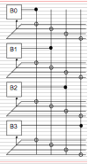
Crossbar Switch
A crossbar is a network connecting each processor to every other processor
Wires do not Intersect unless a circle connection is shown
Crossbars grow as n² making them impractical for large n
Here, only 4 boards are shown, but the Sun Fire D25K has 18 boards

Slide 14
Crossbar in SunFire E25K
X-bar gives low latency for snoops allowing for shared memory
18 x 18 X-bar is basically the limit due to as n² rate of increase
Raising the number of processors per node will, on average, increase congestion
How could we make a larger machine?

Slide 15
Heterogeneous Chip Designs
An alternative to replicating a standard processor several times is to augment a standard processor with one or more specialized attached processors
The standard processor performs the general, hard-to-parallelize part of computation while attached processors perform the compute-intensive portion of the computation
Examples:
Graphics Processing Units (GPU’s)
Field Programmable Gate Arrays (FPGAs)
Cell Processor, designed for video games

Slide 16
A Heterogeneous Chip: The Cell Processor
Cell processor is a joint development by Sony, IBM, and Toshiba.
Has 64- bit PowerPC core and eight specialized cores called synergistic processing elements (SPEs)
Each SPE supports 32 bit vector operations.
High speed Element Interconnect Bus (EIB) connecting SPEs
SPEs capable of supporting vector instructions, with one operation performed on several data values in parallel.
Cell emphasizes performance and hardware simplicity over programming convenience.
SPEs do not have coherent memory
Programmers must carefully manage movement of data to and from the SPEs so that the vector units can be kept busy.
When successful, Cell processors can produce impressive throughputs.

Slide 17
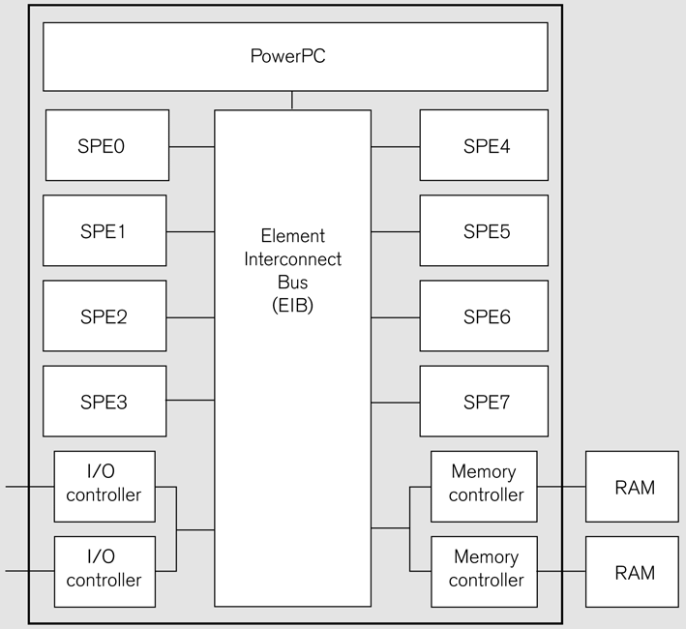
Figure 2.6 Architecture of the Cell processor. The architecture is designed to move data: The high speed I/O controllers have a capacity of 76.8 GB/s; each of the two channels to RAM runs at 12.8 GB/s; the capacity of the EIB is theoretically capable of 204.8 GB/s.

Slide 18
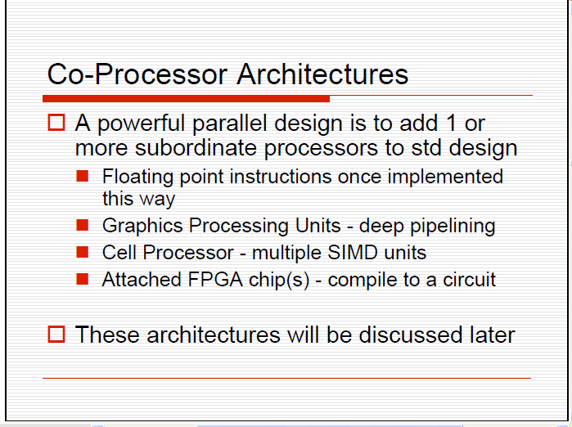

Slide 19
Clusters
Parallel computers made from commodity parts
Nodes connected by commodity interconnects, such as Gigabit Ethernet, Myrinet, Infiniband, etc.
Instructions for assembling a typical system such as below are available on WWW.
8 nodes consisting of a 8-way Power4 processor with 32GB RAM, 2 disks
One control processor
Myrinet 16 port switch plus 8 PCI adapters on 4 boards
Open Source software
Can also be built using pre-packaged blade servers. More detail on how to build given in textbook.

Slide 20
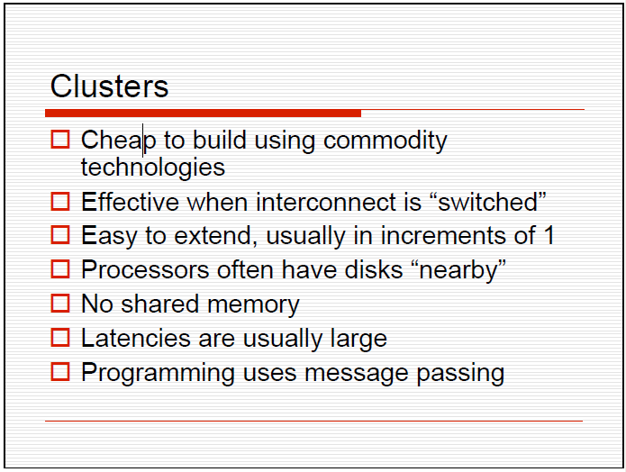

Slide 21
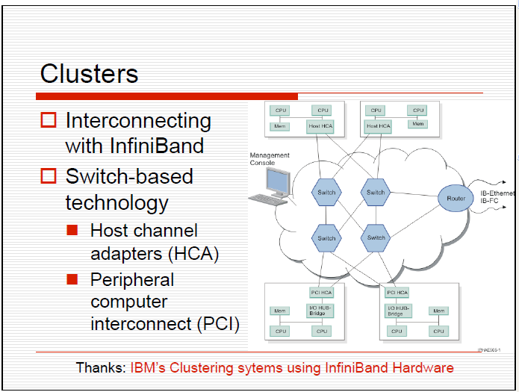

Slide 22
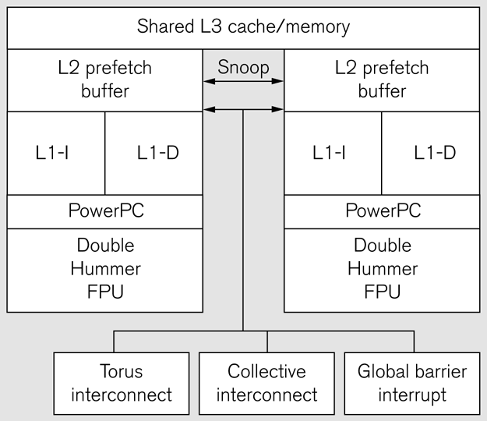
Supercomputer: Blue Gene/L Node
Below diagram gives logical organization of a BG/L node.
BG/L has 65,536 dual core nodes
Processors run at a moderate 770 MHz speed

Slide 23
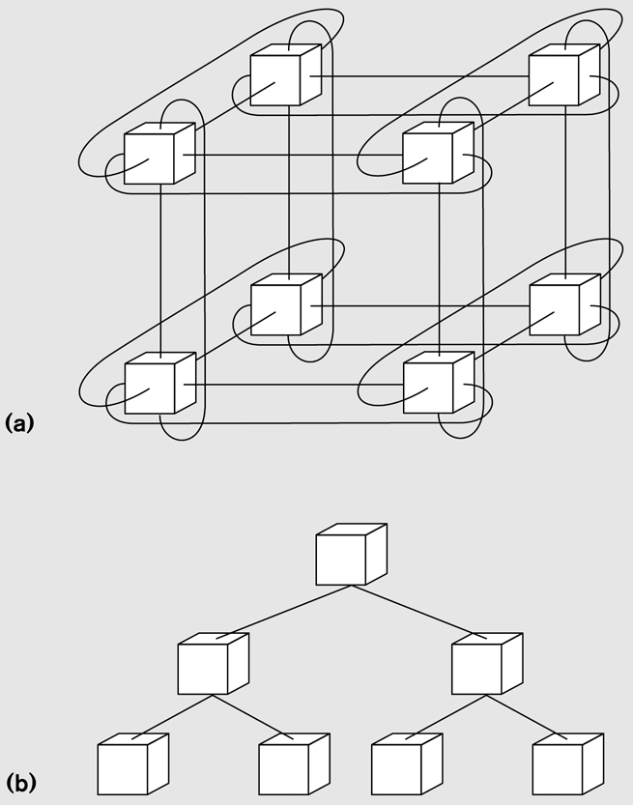
BG/L Interconnect
Separate networks for control and data
Can then specialize network implementation for type of message
Also reduces congestion
3D torus is for standard interprocessor transfer
Collective network used for fast evaluation of reductions
Entire BG/L expands to 64×32×32
3-d torus
collective network

Slide 24
Blue Gene/L Specs
BG/L was the fastest computer in the world (#1 on the Top500 List) when the textbook was published
A 64x32x32 torus = 65K 2-core processors
Cut-through routing gives a worst-case latency of 6.4 µs
Processor nodes are dual PPC-440 with “double hummer” FPUs
Collective network performs global reduce for the “usual” functions

Slide 25
Summary of Architectures
Two main classes
Complete connection: CMPs, SMPs, X-bar
CMPs are Chip Multiprocessors
Preserve single memory image
Complete connection limits scaling to …
Available to everyone (multi-core)
Sparse connection: Clusters, Supercomputers, Networked computers used for parallelism (Grid)
Separate memory images
Can grow “arbitrarily” large
Available to everyone with LOTS of air conditioning
Programming differences are significant

Slide 26
Parallel Architecture Model
How to develop portable parallel algorithms for current and future parallel architectures, a moving target?
Strategy:
Adopt an abstract parallel machine model for use in thinking about algorithms
Review how we compare algorithms on sequential architectures
Introduce the CTA model (Candidate Type Architecture)
Discuss how it relates to today’s set of machines

Slide 27
How did we do it for sequential architectures?
Sequential Model: Random Access Machine
Control, ALU, (Unlimited) Memory, [Input, Output]
Fetch/execute cycle runs 1 inst. pointed at by PC
Memory references are “unit time” independent of location
Gives RAM it’s name in preference to von Neumann
“Unit time” is not literally true, but caches provide that illusion when effective
Executes “3-address” instructions
Focus in developing sequential algorithms, at least in courses, is on reducing amount of computation (useful even if imprecise)
Treat memory time as negligible
Ignore overheads

Slide 28
Interesting Historical Parallel Architecture Model, PRAM
Parallel Random Access Machine (PRAM)
Unlimited number of processors
Processors are standard RAM machines, executing synchronously
Memory reference is “unit time”
Outcome of collisions at memory specified
EREW, CREW, CRCW …
Model fails to capture true performance behavior for most current architecture.
Synchronous execution w/ unit cost memory reference does not scale (for multi-tasking type executions)
Therefore, parallel hardware typically implements non-uniform cost memory reference

Slide 29
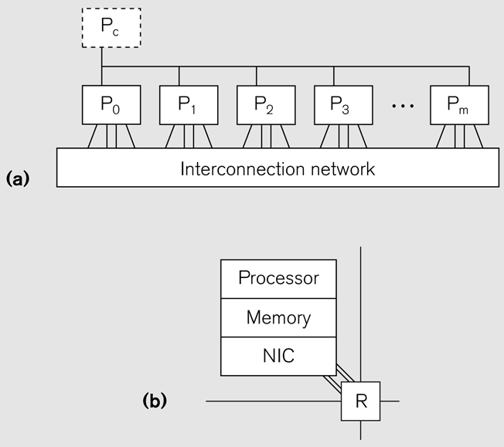
Candidate Type Architecture (CTA Model)
A model with P standard processors, d degree, λ latency
Node == processor + memory + *NIC
Key Property: Local memory ref is 1, global memory is λ
*NIC is the network interface chip. See pg 48 of text

Slide 30
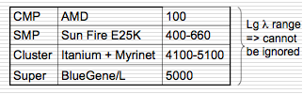
Estimated Values for Lambda
Captures inherent property that data locality is important.
But different values of Lambda can lead to different algorithm strategies

Slide 31
Key Lesson from CTA
Locality Rule:
Fast programs tend to maximize the number of local memory references and minimize the number of non-local memory references.
Keep as much of the memory access as possible private (i.e., where λ=1) .
As much as possible, use non-private memory access (i.e., where λ>1) only for communications and not for data movement.
Locality Rule in practice
It is usually more efficient to add a fair amount of redundant computation to avoid non-local accesses (e.g., random number generator example).
This is the most important thing you will learn in this class!

Slide 32
Back to Abstract Parallel Architecture
A key feature is how memory is connected processors!

Slide 33
Memory Reference Mechanisms
Shared Memory
All processors have access to a global address space
Refer to remote data or local data in the same way, through normal loads and stores
Usually, caches must be kept coherent with global store
Message Passing & Distributed Memory
Memory is partitioned and a partition is associated with an individual processor
Remote data access through explicit communication (sends and receives)
Two-sided (both a send and receive are needed)
One-Sided Communication (a hybrid mechanism)
Supports a global shared address space but no coherence guarantees
Access to remote data through gets and puts

Slide 34
Brief Discussion
Why is it good to have different parallel architectures?
Some may be better suited for specific application domains
Some may be better suited for a particular community
Cost
Explore new ideas
And different programming models/languages?
Relate to architectural features
Application domains, user community, cost, exploring new ideas

Slide 35
Conceptual: CTA for Shared Memory Architectures?
CTA is not capturing global memory in SMPs
Forces a discipline
Application developer should think about locality even if remote data is referenced identically to local data!
Otherwise, performance will suffer
Anecdotally, codes written for distributed memory shown to run faster on shared memory architectures than shared memory programs
Similarly, GPU codes (which require a partitioning of memory) recently shown to run well on conventional multi-core

Slide 36
Summary of Lecture
Exploration of different kinds of parallel architectures
Key features
How processors are connected?
How memory is connected to processors?
How parallelism is represented/managed?
Models for parallel architectures

